Slide 1

Questing and NPCs
Thomas Towson
Presentation for VGP 2

Slide 2
QUEST SYSTEM
Quest Manager …………………………………………………………………………………………………………………………… 3
Quest Marker ……………………………………………………………………………………………………………………………… 4
Quest Trigger ……………………………………………………………………………………………………………………………… 5
Quest Menu ………………………………………………………………………………………………………………………………… 6
Quest List ……………………………………………………………………………………………………………………………………. 7
Quest Functions …………………………………………………………………………………………………………………………. 8
2

Slide 3
QUEST MANAGER
Functions:
Manages all quests in the game
Can save and load quests and their states
Keeps track of all quests and their states
3

Slide 4
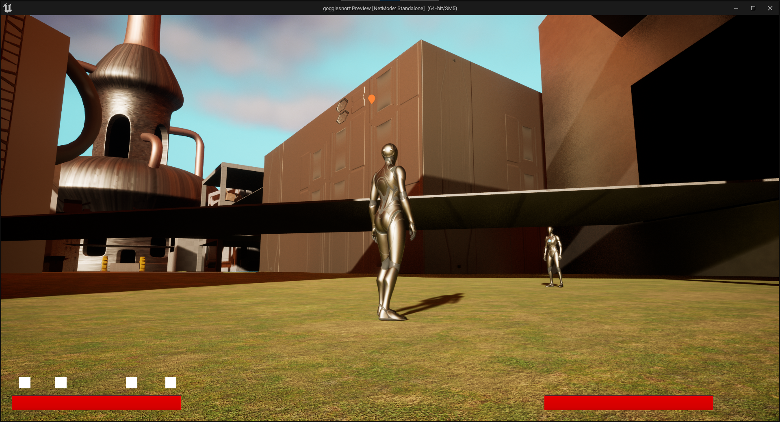
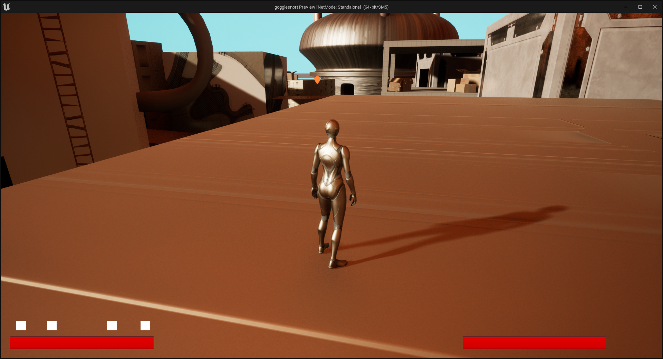
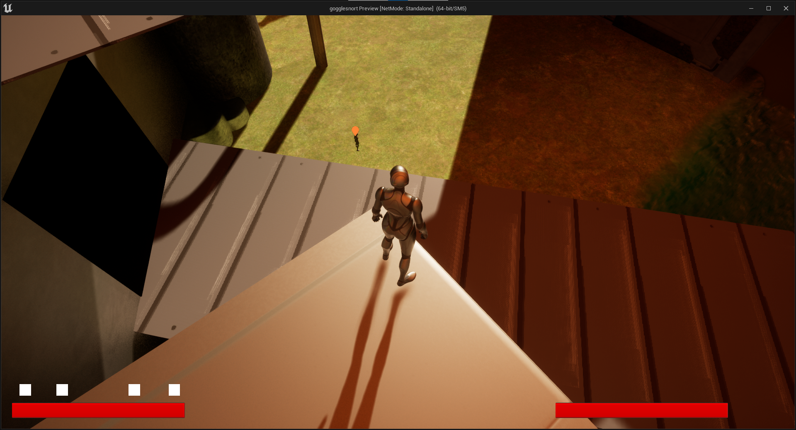
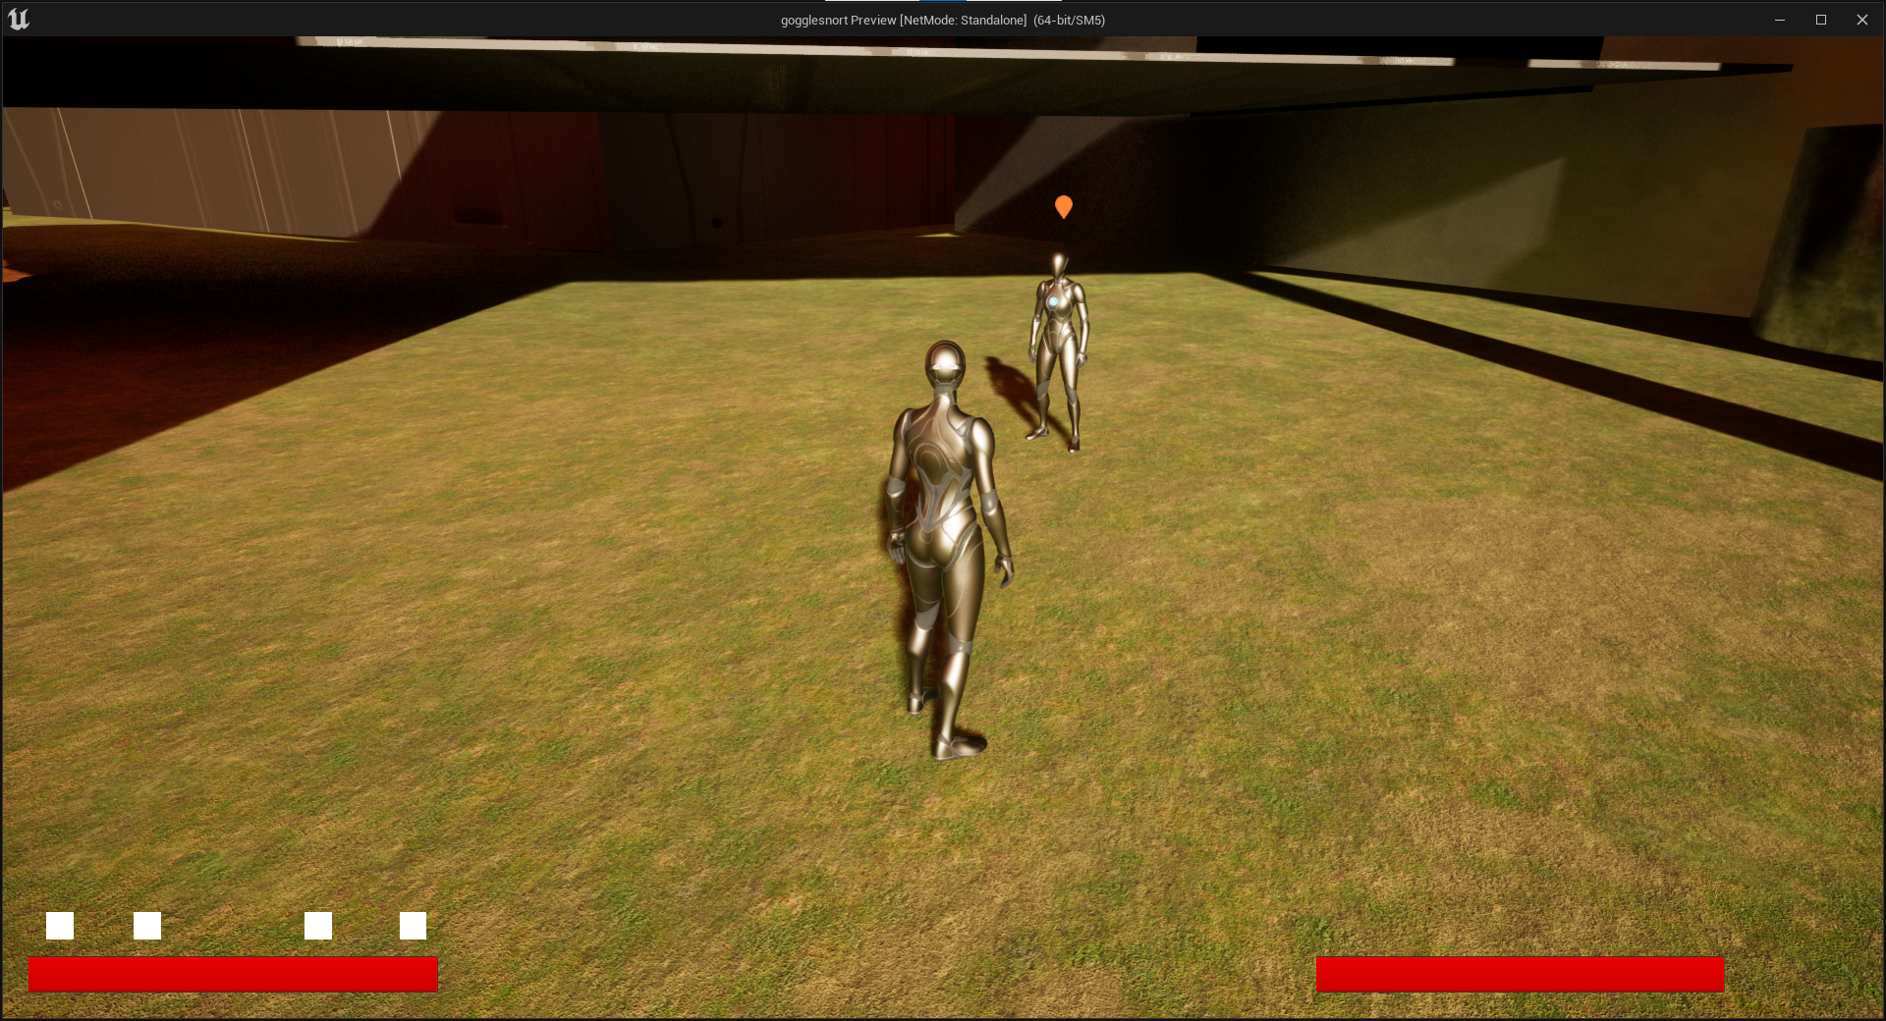
QUEST MARKER
Functions:
Can be placed anywhere in levels
Displays when quest is active
Hides otherwise
Renders above all geometry
Can appear in different colors
4

Slide 5
QUEST TRIGGER
Functions:
Basically an invisible box
Completes a level quest when walked into
5

Slide 6
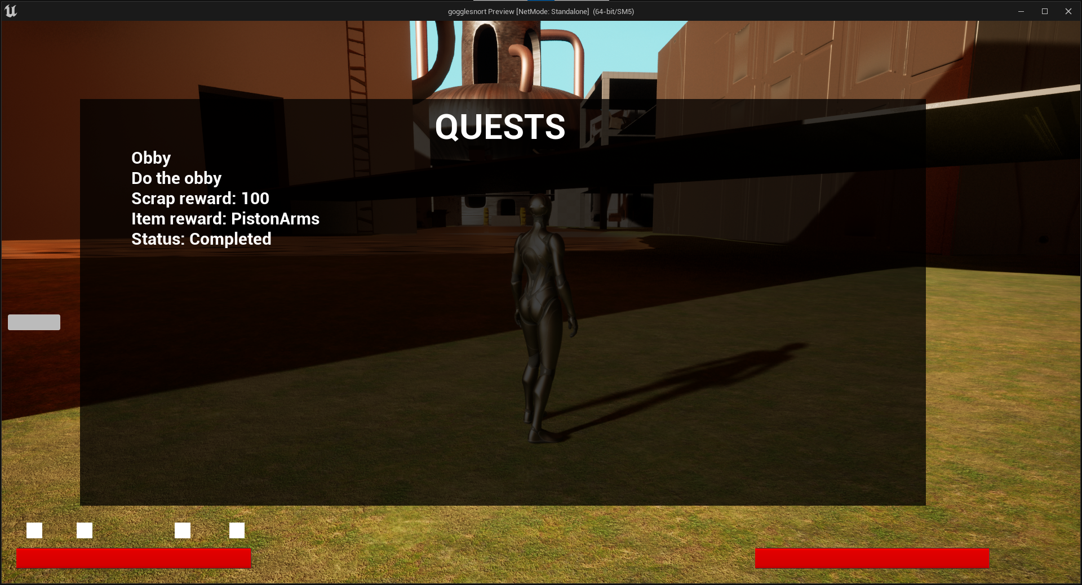
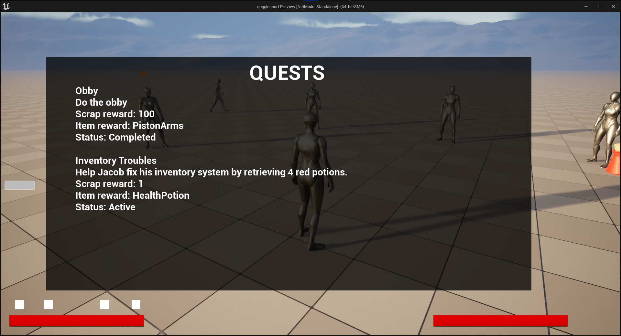
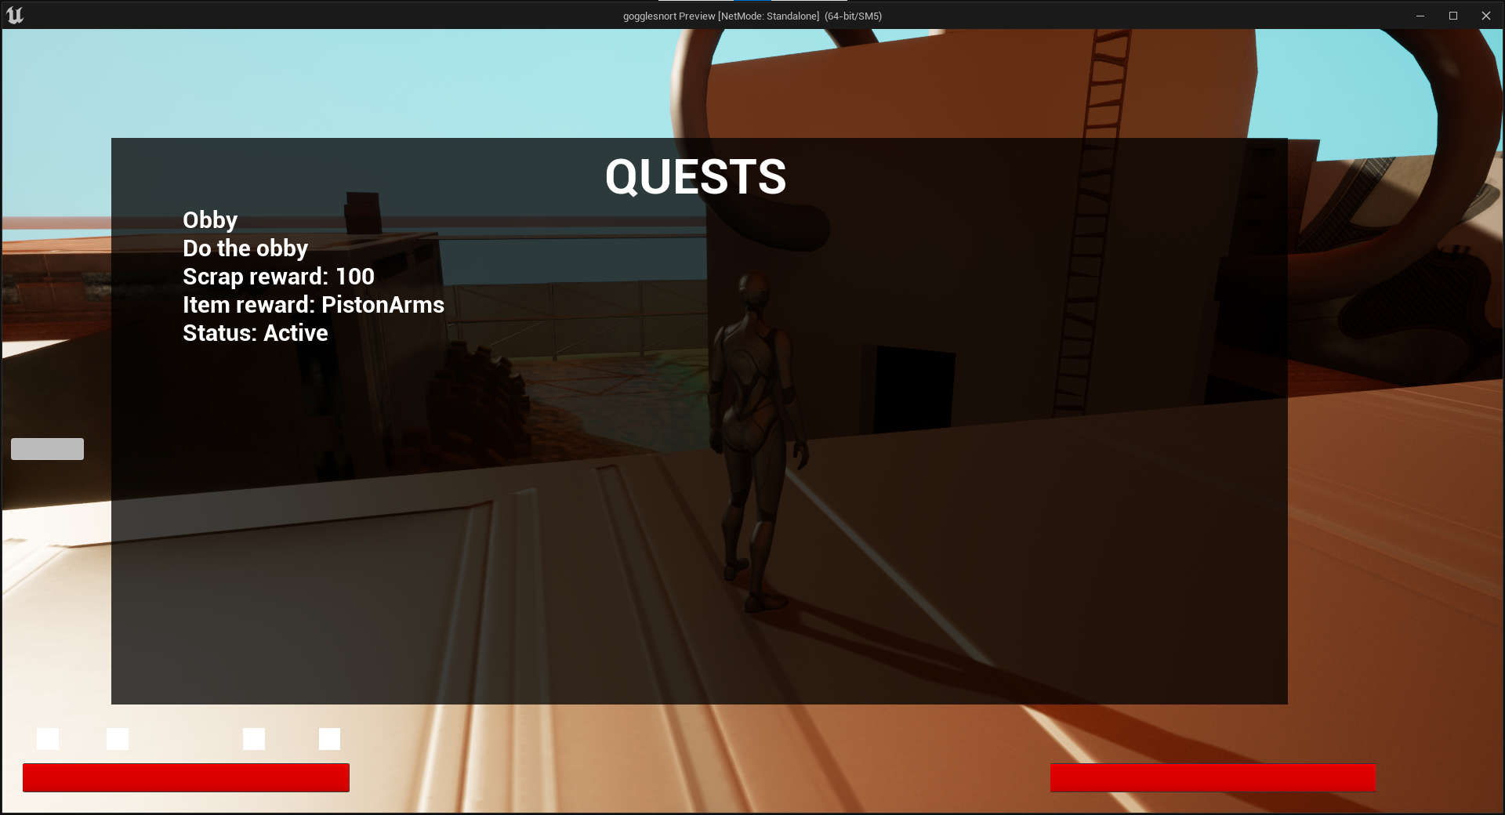
QUEST MENU
Functions:
Displays active and completed quests
Can display multiple quests
Included info:
Quest name
Quest description
Quest rewards
Quest state
Displays completed quests at the top
6

Slide 7
QUEST LIST
Functions:
Used to hold all of the quests in the game
Is loaded into the quest manager when needed
7

Slide 8
QUEST FUNCTIONS
Function:
A library of functions that manipulate and return quests
Is used by almost all items that have something to do with quests
8

Slide 9
NPCS
Quest NPC ………………………………………………………………………………………………………………………………… 10
Talking NPC ……………………………………………………………………………………………………………………………..… 11
Roam NPC …………………………………………………………………………………………………………………………………. 12
9

Slide 10
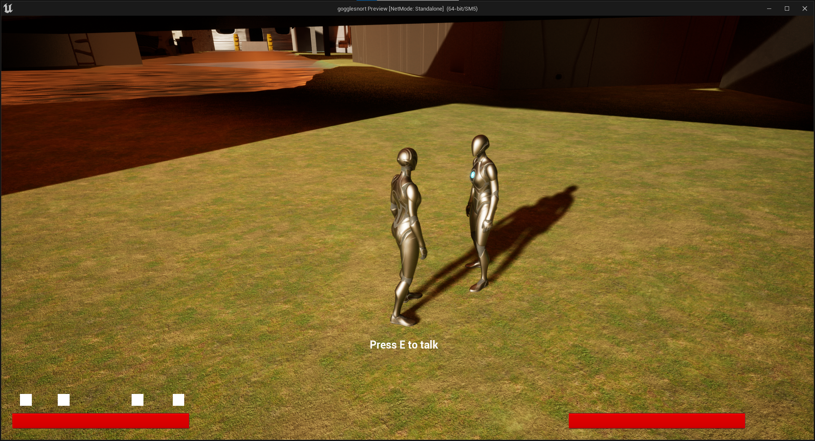
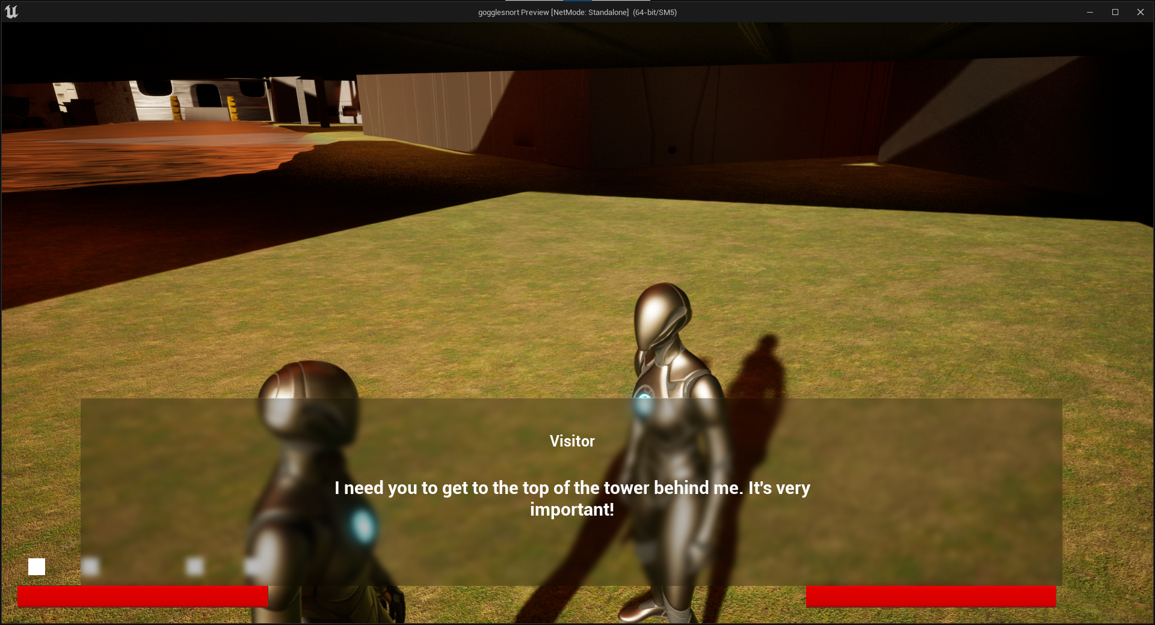
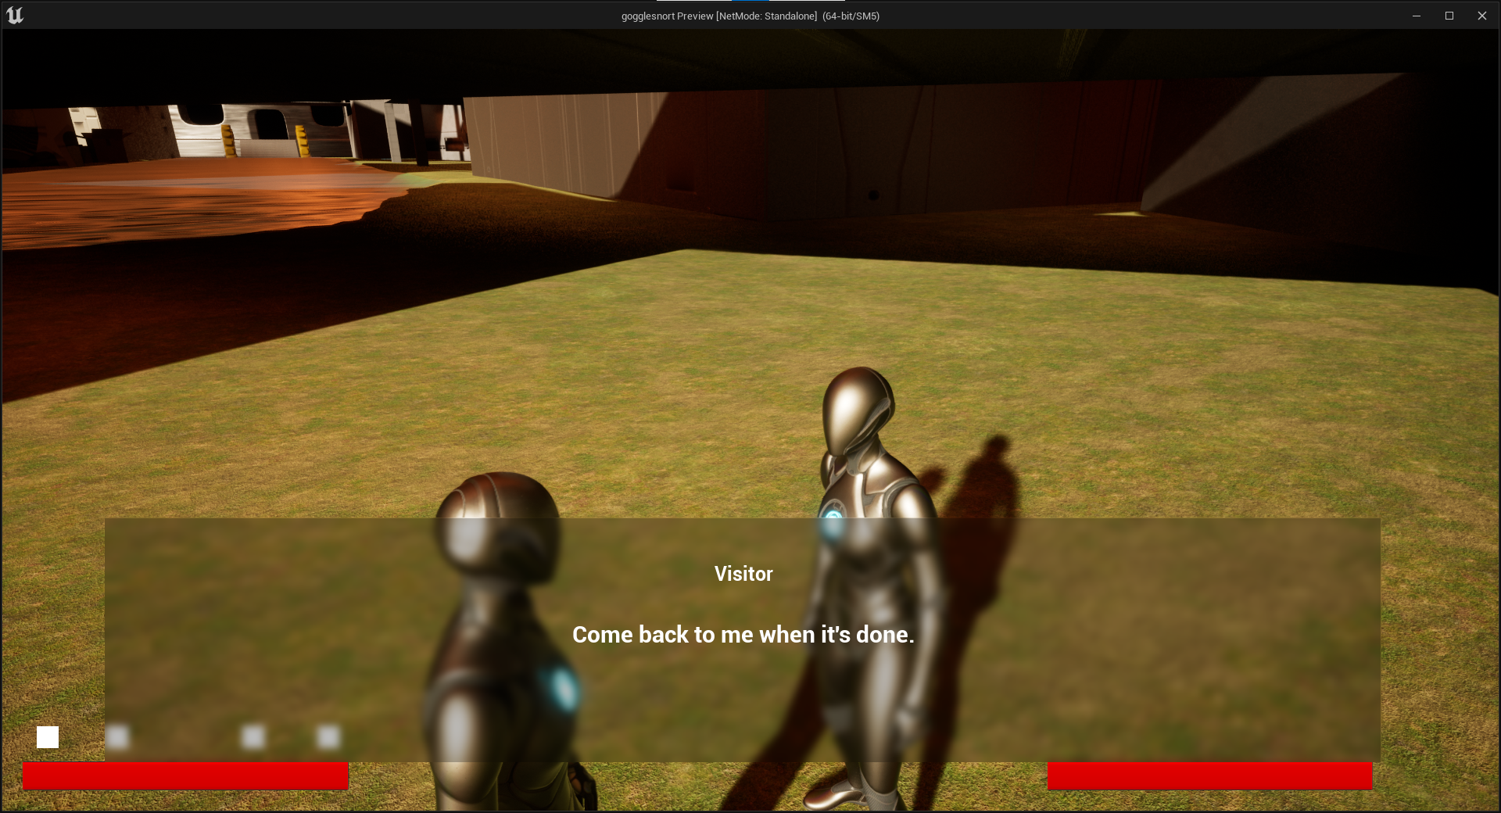
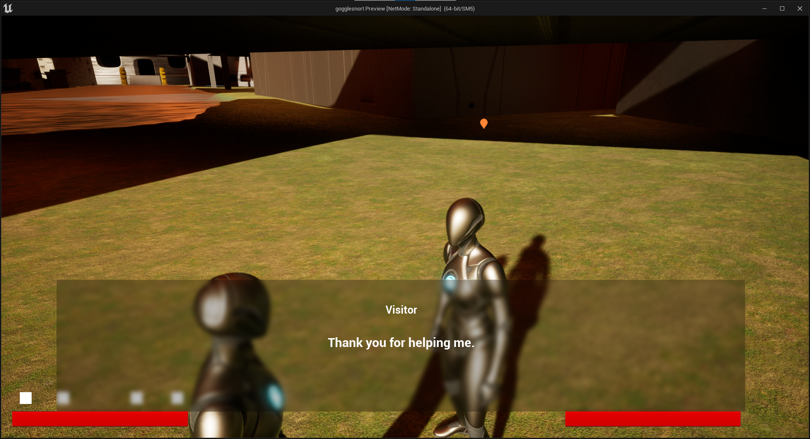
QUEST NPC
Functions:
Will look at the player when close
Can be talked to by pressing “E”
A text box appears with info:
NPC’s name
NPC’s dialogue
Dialogue is animated
Camera focuses on player and NPC
NPC can give quests to the player
NPC says different dialogue depending on its quest status
10

Slide 11
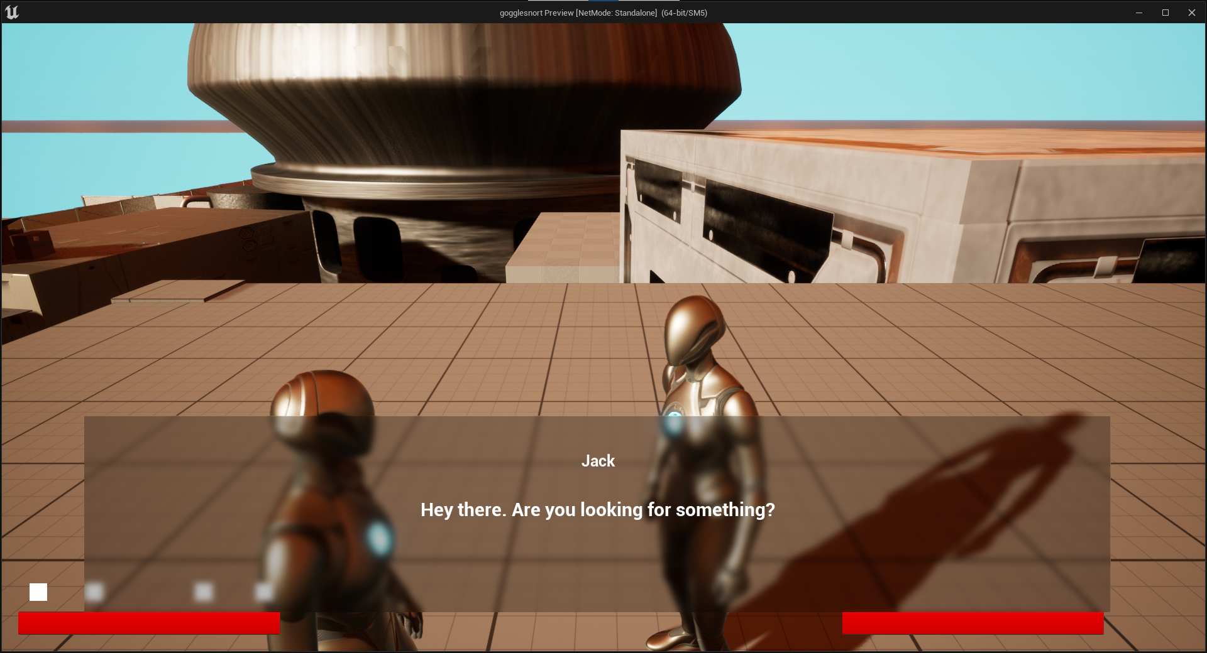
TALKING NPC
Functions:
Will look at the player when close
Can be talked to by pressing “E”
A text box appears with info:
NPC’s name
NPC’s dialogue
Dialogue is animated
Camera focuses on player and NPC
NPC can be talked to multiple times
Used to add enhance environment and story
11

Slide 12
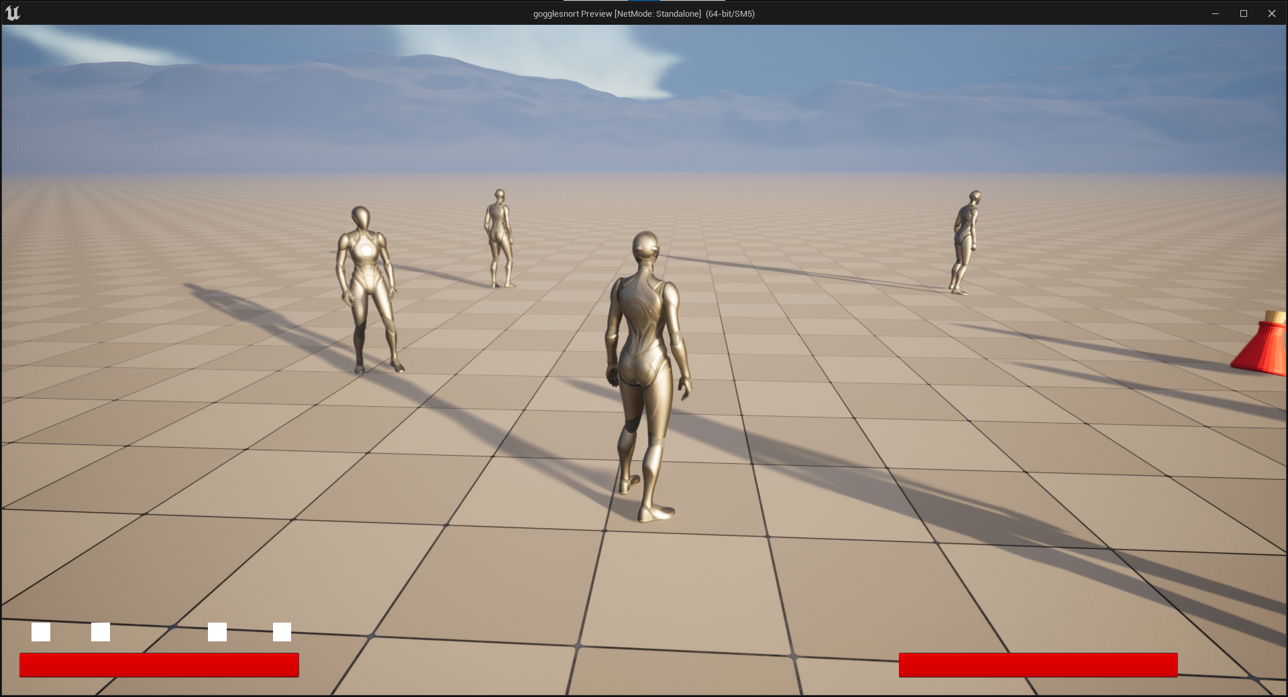
ROAM NPC
Functions:
Roam around the level in a set radius
Can walk onto anything accessible by them
Will look at the player when close
Used to enhance environment
12

Slide 13
OTHER
Start Menu ………………………………………………………………………………………………………………………………… 14
Death Screen …………………………………………………………………………………………………………………………..… 15
Quest System & NPCs Documentation ………………………………………………………………………………………. 16
13

Slide 14
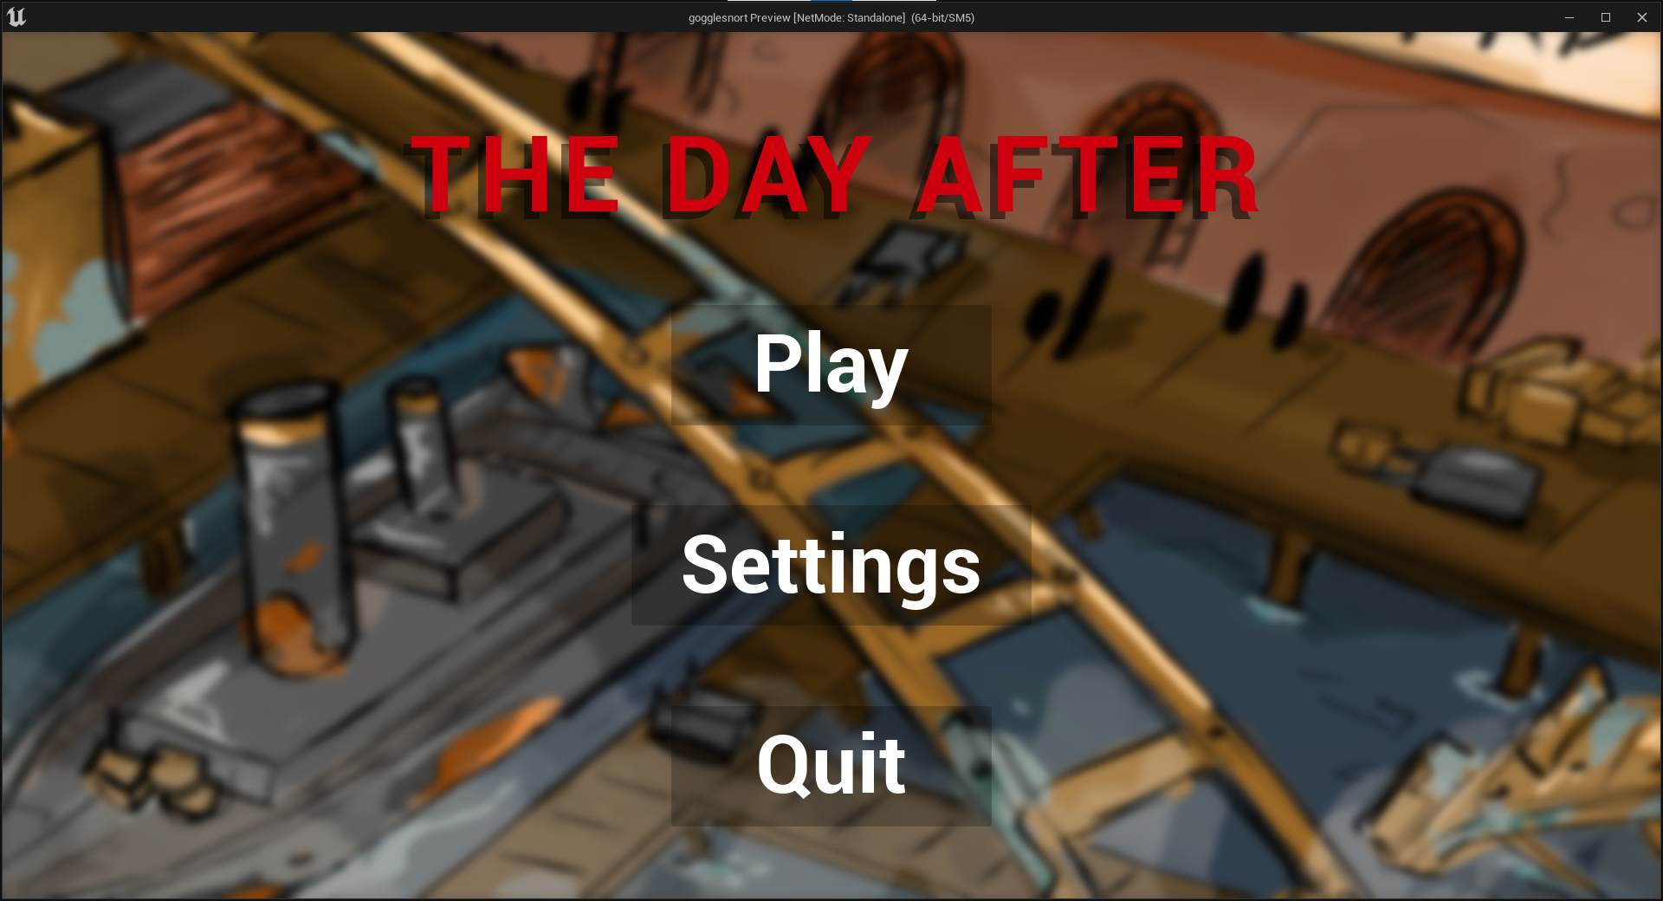
START MENU
Functions:
Background moves with mouse
Play button starts game
Settings button opens settings
Quit button ends game
14

Slide 15
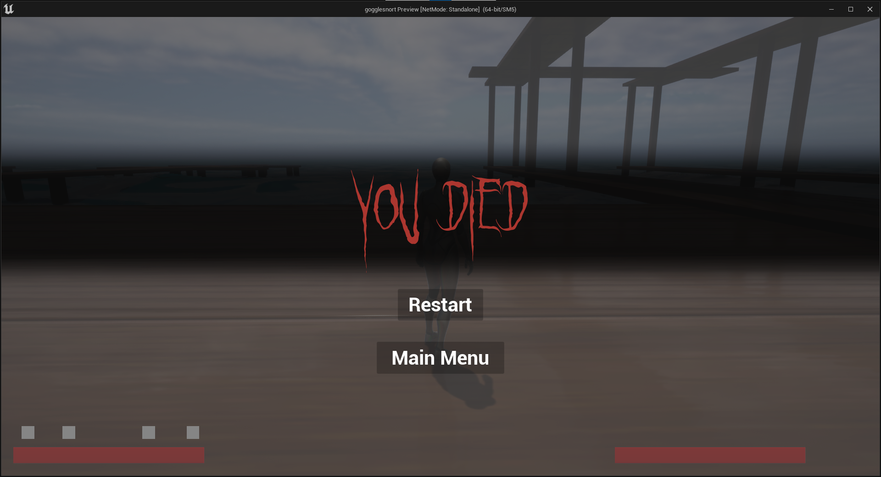
DEATH SCREEN
Functions:
Screen fades in on player death
Player ragdolls on death
Restart button reloads current level
Main Menu button loads main menu level
15

Slide 16
DOCUMENTATION
Documentation can be seen here.
16

